Slide 1
CS61C: Great Ideas in Computer Architecture (aka Machine Structures)
Lecture 37: Dependability
Instructors: Lisa Yan, Justin Yokota

Slide 2
Agenda
Dependability
Error Correcting Codes
RAID

Slide 3
Agenda
Dependability
Error Correcting Codes
RAID

Slide 4
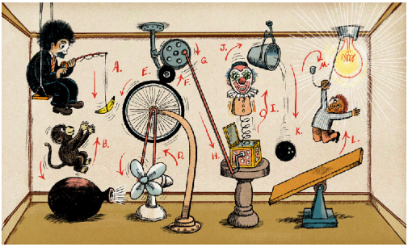
Introduction: Rube Goldberg Machines
Notes:
Pass the Wine - My Most Complex Machine Ever? - YouTube

Slide 5
Introduction: Rube Goldberg Machines
The big problem with Rube Goldberg Machines is that every step needs to go exactly right for the entire machine to work
Each step adds some (ideally small) chance of failure
20 steps at 95% success rate gives ~37% chance of success overall
100 steps at 95% success rate gives ~1/168 chance of success

Slide 6
Dependability
Computers are effectively electrical Rube Goldberg machines
Modern systems are fairly reliable, but errors still happen occasionally
Network systems: ~10⁻⁹ chance of bit flip
DRAM: Cosmic rays at Earth sea level give a ~10⁻¹³ chance of a specific bit flipping per second (2009).
Error rates are higher for more modern systems (due to there being lower difference between a 1 bit and a 0 bit), and generally higher in space/high altitude environments.
Larger failures could damage the entire disk, with probability ~1% per year.
Seems like a small amount, but we often deal with GiB at a time.
Downloading a 2 hour movie would have ~2 GiB * 10⁻⁹ = 10-20 bit errors in the download
Conclusion: Failure is not an option. It is mandatory.
We need a way to mitigate the effects of failure.
Notes:
Bit-Error Rate (BER) - PathFinder Digital Wiki paper.dvi (toronto.edu)

Slide 7
Availability: Definitions
Motivating example: You have some tool/service. Every now and then it fails, so it's unavailable until you fix it.
Mean Time to Failure (MTTF): Average time it takes for an entirely new system to fail.
Mean Time to Repair (MTTR): Average time it takes to fix the tool once it breaks.
Mean Time Between Failures (MTBF): Average time to complete one "cycle" of working->broken->working.
Equal to MTTF+MTTR
Availability: Percentage of the time that the service is available
Equal to MTTF/MTBF

Slide 8
Availability Example
My laptop broke three times in 2022 (right after the warranty expired…)
Each failure prevented me from using the laptop for ~1 week (needed to find parts online, have them shipped, borrow a repair kit, etc.)
MTBF: 1 year / 3 (failures) = 1/3 year or ~120 days
MTTR: 7 days
MTTF: 120 days between failures, but the laptop wasn't in use for 7 of those days. In terms of the actual time I was using the laptop, it failed ~113 days after it got fixed.
Availability: 113 days / 120 days = 113/120 or about 95%

Slide 9
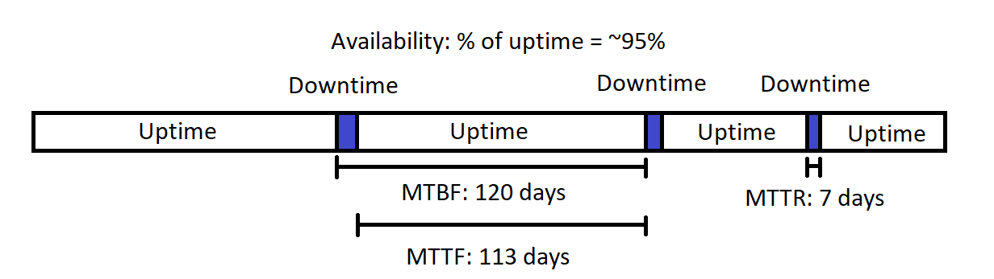
Availability Example

Slide 10
Availability
Common shorthand is "9s of reliability/availability"
1 nine of availability -> 90% available
2 nines of availability -> 99% available
3 nines -> 99.9%
5 nines of availability ->99.999% availability = 5 minutes of repair/year
Extremely expensive to maintain
Another common metric is Annualized Failure Rate: average number of failures per year.
Often around 1-10%, for individual drives, depending on the age of the drive.

Slide 11
Availability
What happens if we have multiple components?
If all our components are critical, then we expect the overall system to fail faster than any individual component
If your battery breaks every two years and your CPU breaks every two years, one of them will break (on average) every year.
On the other hand, if we have two copies of the same system and only need one of them to work, it's extremely unlikely to have both systems fail simultaneously
If two different batteries have an availability of 99%, at least one battery will be working 99.99% of the time.
On the other hand, you'll be at half efficiency 2% of the time.
Major principle in engineering: Add redundancy to systems to reduce the chance of failure
Eliminate all single points of failure.

Slide 12
Dependability Through Redundancy
This ends up showing up a lot in various engineering components
From a hardware perspective, laptops are designed to "fail slowly" by shunting work to any remaining working components
This is why laptops tend to get slower as they age
Today, we'll discuss two specific cases of data redundancy:
Error Correcting Codes
Recover correct binary data even if some bits were corrupted
RAID
Connect multiple hard drives together so that even if one fails, all data is recoverable

Slide 13
Agenda
Dependability
Error Correcting Codes
RAID

Slide 14
Error Correcting Codes
When storing data, there's a very low (but still possible) chance that some of our bits get flipped by cosmic rays.
In order to detect these, we need to store more bits than the initial data we received.
Two major goals:
Detect if an error occurred
Even if we can't fix the error, we can try again/inform the user that something wrong happened.
Correct an error that happened
Generally harder than just detecting an error, but lets you continue running the program even if an error happens.
General assumption is that there's either a fixed number of errors (since it's rare to have multiple errors at once), or a fixed percentage of errors.
Ex. A Hamming Code might be able to detect 2-bit errors, and correct 1-bit errors.
Ex. QR codes use a Reed-Solomon code that can correct up to 7-30% errors, depending on the correction rate requested.

Slide 15
Error Correcting Codes
Example: We start with 4 data bits (16 possible data values)
We use some function f to convert from 4 data bits to a 7-bit codeword
The 16 possible outputs of f are considered the "valid" codewords, because they signify a lack of corruption.
Someone takes that codeword and flips up to 1 bit.
Defensive programming: Assume that the bit flip is malicious and actively trying to make your system fail.
If we are guaranteed that a corruption doesn't get us to another valid codeword, we can detect 1-bit errors
We receive those 7 bits (with potentially one corruption) and use some function g to convert back to 4 data bits.
If we are guaranteed to get back our old data, we can correct 1-bit errors

Slide 16
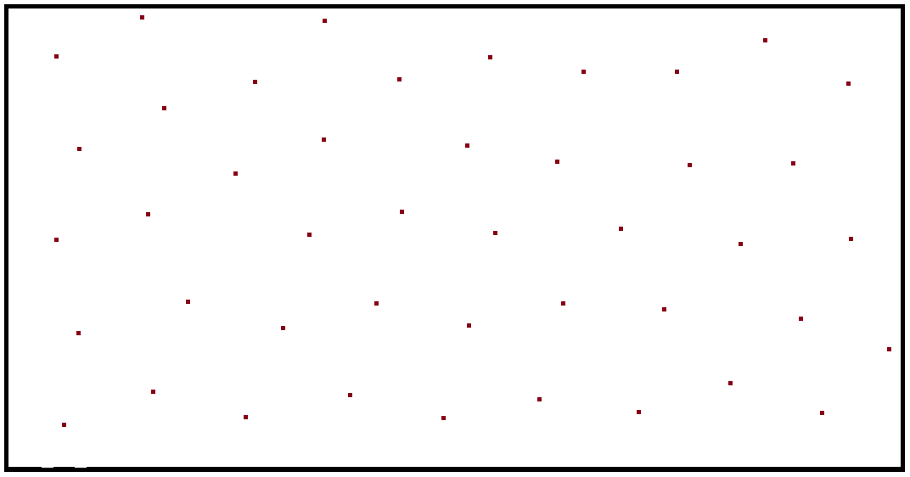
Error Correcting Codes: Graphic

Slide 17
Error Correcting Codes: Maximum to Detect Error

Slide 18
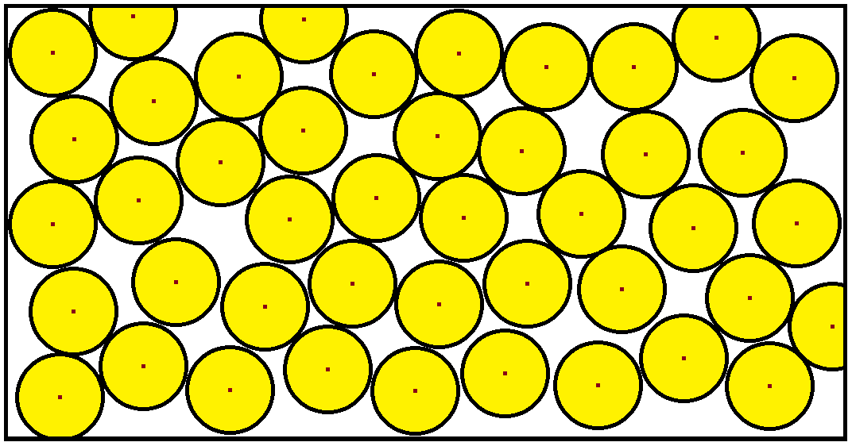
Error Correcting Codes: Maximum to Correct Error

Slide 19
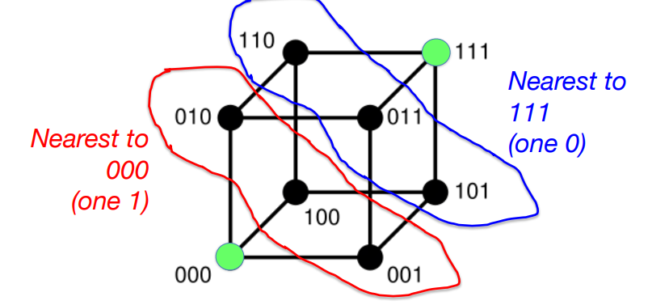
Error Correcting Codes
Generally, you can detect about twice as many errors as you can correct.
As long as your bit space is large enough, you can create an ECC. The goal is to try to find the smallest possible "box" (bit count) that lets us fulfill a given detection/correction requirement.
Reality is more discrete, and n-dimensional, but otherwise the same as the 2-D version (the same concepts work as long as we use a metric space)
Hamming Distance: Number of 1-bit corruptions needed to move from one bitstring to another
Limited by the two closest codewords

Slide 20
Parity Bit
Attempt 1: Store one extra bit so that the parity (number of 1 bits) of the string is even
Ex. If we want to store data 0b1001 1000, our parity bit will be 1, so we store 0b 1 0011 0001
Ex. If we want to store data 0b1001 1001, our parity bit will be 0, so we store 0b 1 0011 0010
To convert back, we can just cut the parity bit.
Can we detect 1-bit errors?
Yes. If one bit gets corrupted, our parity will become odd instead
Can we detect 2-bit errors/correct 1-bit errors?
No: The two example codewords are Hamming distance 2 apart, so if we had two corruptions, we could go from one codeword to another.
Is this optimal to detect 1-bit errors?
Yes. We can't do better than "1 extra bit", since "0 extra bits" would have no invalid codewords.

Slide 21
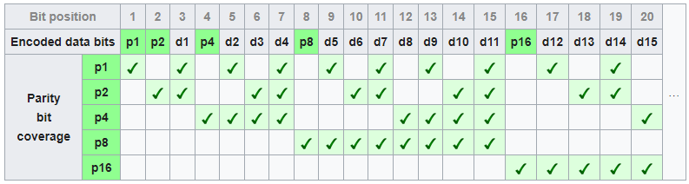
Hamming Code
Main idea of Hamming Codes: Include multiple parity bits (that look at a subset of all bits), so we can pinpoint which bit got corrupted
In the above, d1, d2, … refer to the first, second, … data bits, and p1, p2, … are the parity bits.
Parity bits are chosen such that the bits checked on each row have even parity
Note that no row has multiple parity bits checked, so each parity bit is uniquely determined

Slide 22
Hamming Code: Encoding
Example: Encode 0b 011 0111 0110 as a Hamming code
__0_110_1110110
__0_110_1110110-> Even parity, so p1=0
0_0_110_1110110-> Even parity, so p2=0
000_110_1110110-> Even parity, so p4=0
0000110_1110110-> Odd parity, so p8=1
000011011110110

Slide 23
Hamming Code
To decode a Hamming Code:
Check the parity of each row. If all the rows are correct, no error occurred
If one bit gets corrupted, that'll flip the parities on its column.
Note: Each bit (including parity bits) has a unique set of parity bits it affects, so we can always identify which bit got corrupted
Using that information, we can figure out fix the corrupted bit, and return the correct data
Useful note: If we label bits from 1-n (left to right), the corrupted bit is exactly the binary representation of our parities

Slide 24
Hamming Code: Encoding
Example: Decode 0b 000 0110 1110 0110 as a Hamming code
000011011100110-> Odd parity, so 1
000011011100110-> Odd parity, so 1
000011011100110-> Even parity, so 0
000011011100110-> Odd parity, so 1
Overall parity is 0b1011 = 11, so bit 11 is corrupted
000011011100110
0 110 1100110 (Remove parity bits)

Slide 25
Hamming Code
Thus, allows for correcting 1-bit errors
Can we detect 2-bit errors?
Yes, since no two bits flip all parities an even number of times
Can we detect 3-bit errors?
No; if bits 1,2,3 were corrupted, all our parities would be even.
Is this optimal to correct 1-bit errors?
Yes, because the total "area" covered by circles almost equals the box size
Note: CS 70 describes an ECC that can correct 1 error with 2 extra packets (Berlekamp-Welch). This doesn't apply here because Berlekamp-Welch allows only up to n packets sent at once, where n is the number of letters in our alphabet. For binary, Berlekamp-Welch would only be able to send at most 2 bits at a time.

Slide 26
Agenda
Dependability
Error Correcting Codes
RAID

Slide 27
RAID
Generally, the larger you make a disk, the faster it breaks. As such, it's useful to set up a system where you use many disks together
Goal: Ensure that even if some disks fail, you still have all your data
Goal: Maximize the amount of data you can store
RAID: Redundant Array of Independent Disks
7 different formats (called levels) that can be used to save data (RAID 0 to RAID 6)
RAIDs 2, 3, and 4 are mostly obsolete nowadays, but we'll still mention them (since they lead into RAID 5)
Note: The data written on the disks get Hamming-encoded, so single-bit errors aren't a concern. If a disk fails, we'll know which disk failed, and will lose all data on it.
We'll use for most of these examples a system where we have 4 1 TiB disks we want to put into a RAID array.

Slide 28
RAID 0
No redundancy
Split data over all disks
Ex. 4 1TiB drives combine to store 4 TiB total
Likely better than a single 4 TiB drive because each disk can output data independently (so 4x bandwidth)
Generally useful if redundancy isn't needed
On the other hand, if any disk fails, the entire array fails (because data was lost)
Notes:
Images taken from Wikipedia

Slide 29
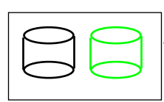
RAID 1
Maximum redundancy
Each disk stores an exact copy of the data
Ex. 4 1 TiB drives combine to store 1 TiB, and three backups
Very reliable (almost always available), but also extremely expensive
Useful for when a system cannot be allowed to fail (ex. life support systems), or when memory use isn't too important.
Notes:
Images taken from Wikipedia

Slide 30
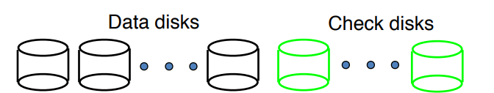
RAID 2
Split the data into several data disks
Each bit gets encoded with a Hamming Code, split across all disks
Ex. If we had 7 1 TiB disks, we would save 4 TiB worth of data. The remaining 3 disks will be used to store parity bits such that the first bit of each disk form a valid 7-bit Hamming code, and so on.
Basically never used; if you want to recover from two disk failures, use RAID 6
Notes:
Images taken from Wikipedia

Slide 31
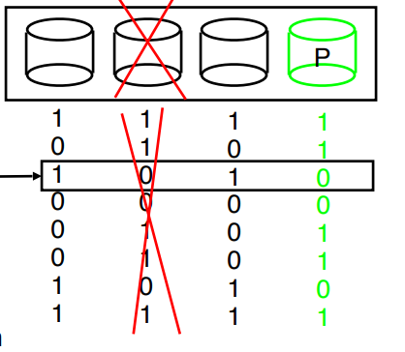
RAID 3
Split the data into several data disks
The last disk is a parity disk, and stores the parity bits of the remaining disks
Ex. 4 1 TiB disks will have 3 TiB of storage and 1 parity disk
If a disk fails, we can recover the old data by taking the parity of all remaining disks. Thus, we can recover from one disk failure.
Never used, since worse than RAID 4
Notes:
Images taken from Wikipedia

Slide 32
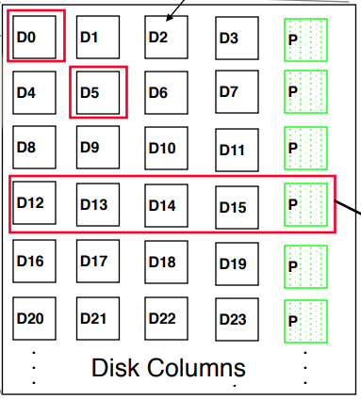
RAID 4
Same as RAID 3, but we instead work at a block level
Instead of writing one byte at a time, chunk memory into blocks of ~100 KiB, and read/write blocks as needed
Use caches to combine multiple small reads/writes in a single operation
Notes:
Images taken from Wikipedia

Slide 33
Problem with RAID 4
Generally, it is possible to do one operation per disk (A single disk can do a single read/write at a time)
It's also possible to do reads/writes from two different disks at the same time.
Ex. In the image on the left (5 disks), if we want to read D0 and D5, we can do so at the same time (1 unit of time). If we wanted to read D0 and D4, though, it would take 2 units of time.
Memory accesses are way longer than math operations, so we only really care about disk reads/writes
Notes:
Images taken from Wikipedia

Slide 34
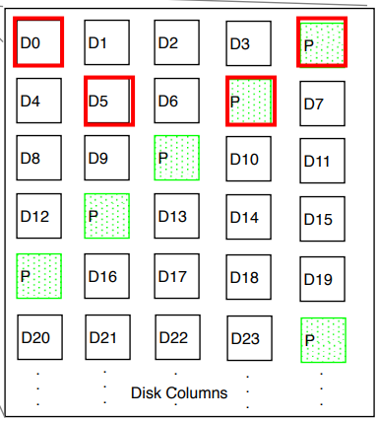
RAID 5
Same as RAID 4, but this time, we interleave parity blocks over all disks
If we want to write to both D0 and D5, disks 1, 2, 4, and 5 all get one write each, so we can finish all writes in 1 unit of time
If we want to write to 100 random blocks, each disk will get ~40 accesses each, so this evens up the work
Notes:
Images taken from Wikipedia

Slide 35
RAID 6
RAID 5's good if we only want to handle one disk failure at a time
As long as disk failures are independent, RAID 5 will likely work
However, failures often happen in close proximity
If the Golden Gate Bridge collapses due to earthquake, there's a good chance the Hayward Bridge will also collapse due to earthquake fairly soon…
RAID 6 introduces a second parity block, (so we get one fewer disk to store data).
This allows us to handle up to two disk failures
Since we work with blocks instead of bits, the number of disks is less than the number of letters in our alphabet, so we don't need to do Hamming Encoding, and can just do Berlekamp-Welch or a derivative
Notes:
Images taken from Wikipedia

Slide 36
Other RAID options
We can nest RAID levels to fine-tune our array to the situation
Ex. If we have 4 disks, we can treat it as two sets of 2 disks each, with the disks in a set having identical data. This is called RAID 10, since it's two RAID 1 systems that combine in a RAID 0 format.
We can also keep a spare disk entirely unused (but already installed), so we can replace it quickly when one disk fails, to reduce the chance that a third disk fails before we finish repairing the first one.
Called a "hot spare".
Notes:
Images taken from Wikipedia

Slide 37
Conclusion
Failures will occur
However, we have ways to mitigate the damage
Generally, there's a tradeoff between dependability and memory use/runtime, so this ends up being another factor to consider when making design decisions.
Notes:
Images taken from Wikipedia

